Slide 1
Aphasia Classification
A final project Presentation
for CS562 with professor Steven Bedrick
By Kendra Chalkley

Slide 2
The Project
6. Improvements
Given
Phonological representations
Of speech errors made by patients with aphasia
And the target word the patient was intended to say
Predict
The type of error represented
Using
An LSTM classifier
With embedded inputs representing both the production and the target
1. ARPAbet
2. Aphasia Errors
5. Prediction Results
4. Architecture
3. Embeddings

Slide 3
The problem
Aphasia and how to represent it

Slide 4
1. ARPAbet
ASCII based phonological representation of American English
Developed by the (Defense) Advanced Research Projects Agency (D)ARPA
English to ARPAbet dictionary available from Carnegie Mellon
CMUdict: http://www.speech.cs.cmu.edu/cgi-bin/cmudict

Slide 5
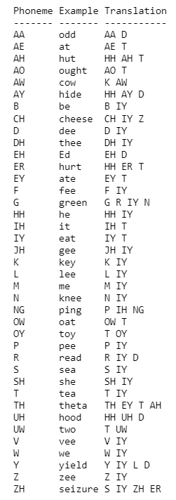
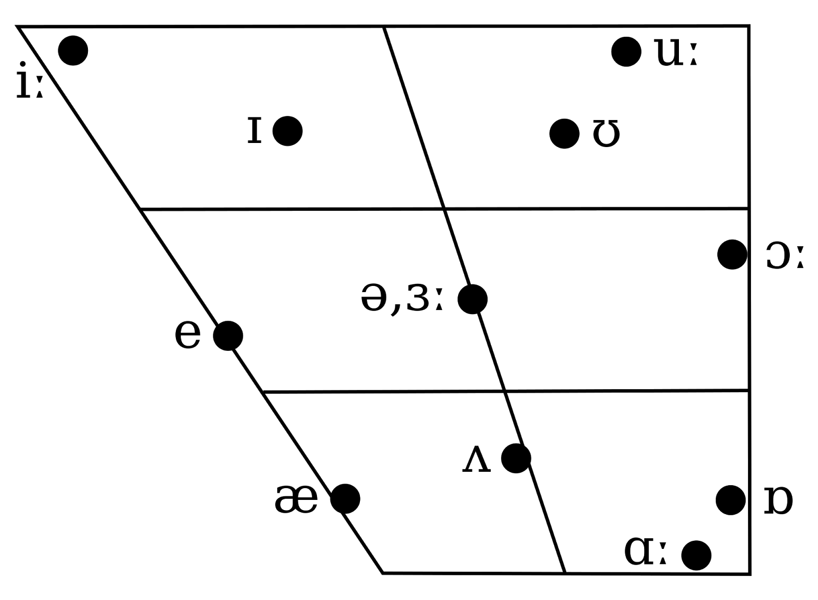
1. ARPAbet
IY
UW
IH
UH
EY
AX, EH
AO
?
AH
AE
AA

Slide 6
2. Aphasia
Neurogenic language disorder from brain injury
Impaired spoken and written language expression and comprehension
Patients often retain relatively intact nonlinguistic cognitive skills
~180,000 new cases in the US per year
~1 in 250 people in the US are living with aphasia
American Speech-Language-Hearing Association

Slide 7
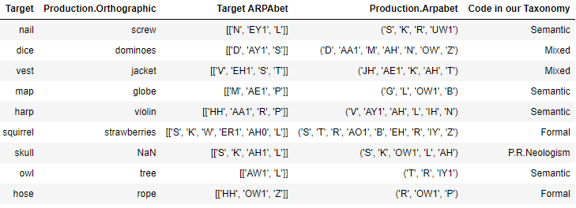
2. AphasiA
Notes:
Two classes – phonological and non.

Slide 8
The Machines
Character Embeddings and
LSTM Classifier

Slide 9
3. Character Embedding
CMU dict, n=133,279
‘AW’
‘L’
<EOS>
Nearly identical to HW3
More embedding layers and few linear layers, trying to push more information back.
86 chars -> 32 embedding dims
32 ->20 hidden lstm dims
20 -> 86 linear layer
86 -> softmax
Mysterious loss of loss with bidirectional LSTM
Linear/
Softmax Layer
x86
x86
x86
LSTM
Layer
20
20
h0
h1
h2
Embedding
Layer
x32
x32
x32
<BOS>
‘AW’
‘L’

Slide 10
4. Classifier
Jumpstarted with embedding layer from previous
32 ->20 hidden lstm dims
20 -> 6 linear layer
6 -> softmax
Semantic
x6
h0
20
h0
<BOS>
‘T’
‘R’
‘IY’
<EOS>
‘AW’
‘L’
Paralg: train n=4690, val n =1155, test n=1256

Slide 11
4. Classifier 2!
Semantic
The original plan was to encode production and target words separately, and learn the relation between their LSTM representations.
I forgot and made the other machine first.
x6
20
^
40
Linear Layer
LSTM
LSTM
Production
Target
<BOS> AW L <EOS>
T R IY

Slide 12
Results and Conclusions
???

Slide 13
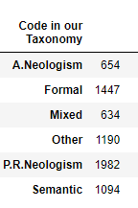
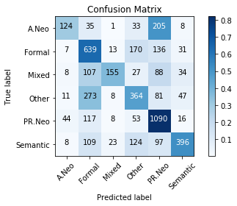
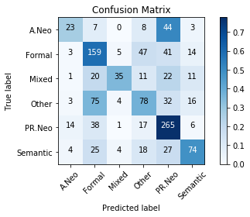
Parallel LSTMs
1982 / 7001
=28.3%
Train LSTM2 59%
Val LSTM2 55%

Slide 14
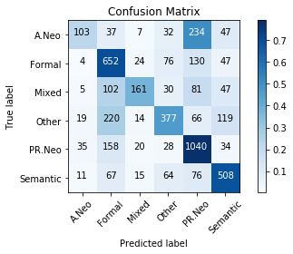
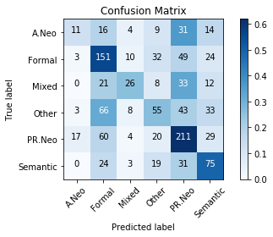
Sequential P+T
Train LSTM1 60.1%
Val LSTM1 45.1%

Slide 15
Comparison
Val LSTM2 55%
Val LSTM1 45%

Slide 16
Binary Phonological Classifier

Slide 17
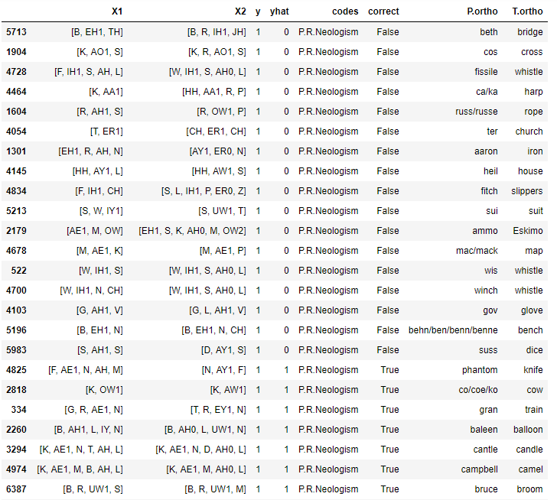
+phon PR Neo
+Phon labeled -Phon
Correctly IDed Phonological Errors

Slide 18
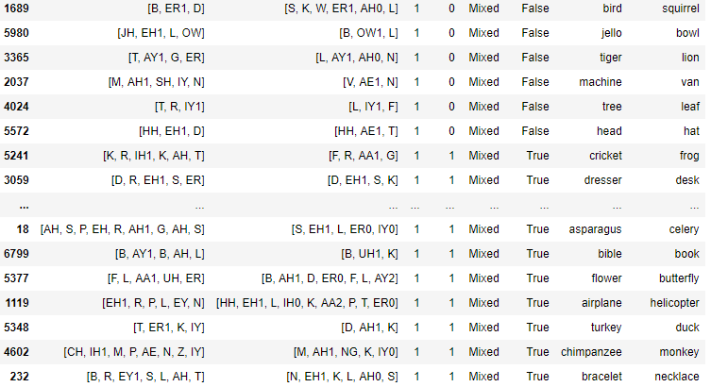
+phon Mixed
Production Target
Production Target
+Phon labeled -Phon
Correctly IDed Phonological Errors

Slide 19
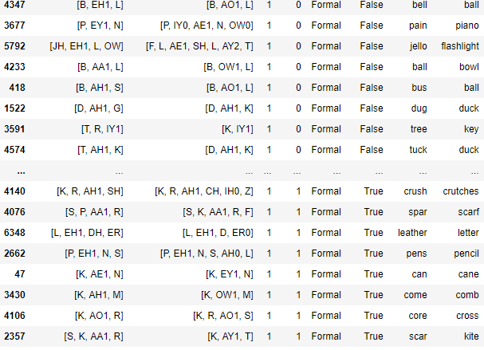
+phon Formal
Production Target
Production Target
+Phon labeled -Phon
Correctly IDed Phonological Errors

Slide 20
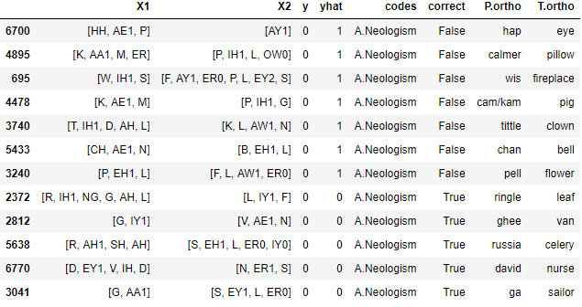
-Phon A Neo
-Phon labeled +Phon
Correctly IDed
-Phon Errors

Slide 21
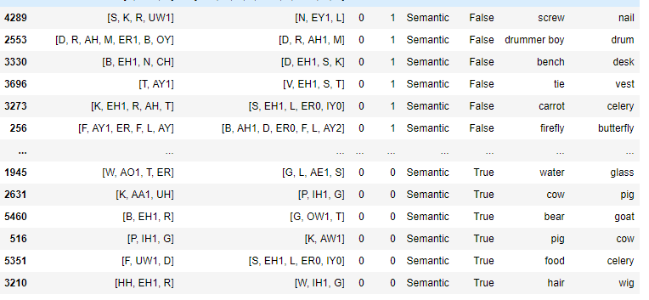
-Phon Semantic
-Phon labeled +Phon
Correctly IDed
-Phon Errors

Slide 22
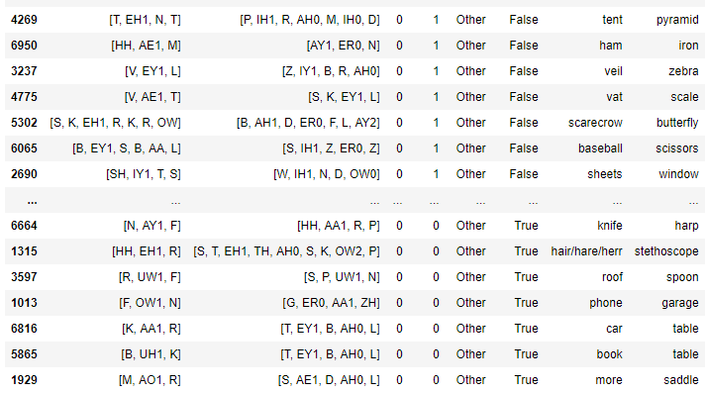
-Phon Formal
Production Target
Production Target
-Phon labeled +Phon
Correctly IDed
-Phon Errors

Slide 23
Model Accuracy
Notes:
Octopus 9phon 2 –phon, Therm 8 phon

Slide 24
The Future!
More error analysis
Compare embedding weights before and after classification training (a la ISI)
Improve to a better architecture

Slide 25
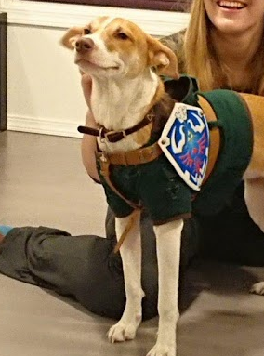
Thanks!

